Slide 1
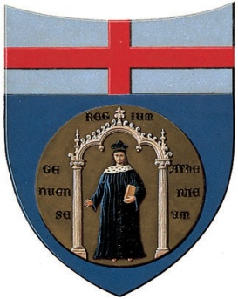
Consortium Euro-Méditerranéen TETHYS Réunion du Conseil d’Administration 19-20 Février 2010
The High-Tech Clusters in Liguria
Daniele Caviglia
University of Genoa

Slide 2
Regional Competitiveness
In a knowledge-driven economy, new job and wealth creation derive from the accelerated commercialization of innovative, world-class technological products and services
A region’s accumulated research and innovation assets may enable the growth of entrepreneurial knowledge-based enterprises in that region
High-Tech Clusters represent instruments with great potential to improve the level of technology and the competitiveness of the productive system in a given territory: they are regional aggregations of high-technology-content activities, including both research activities and industrial production
Within this model the regional government plays a crucial role in identifying each Cluster mission, in defining the strengths and weaknesses of the territorial area concerned, in initiating innovation activities and in identifying potentially positive social and economic dynamics

Slide 3
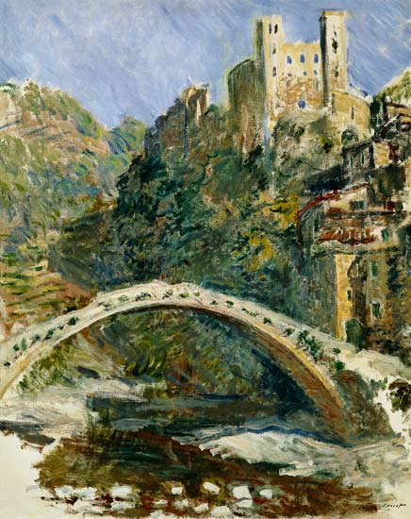
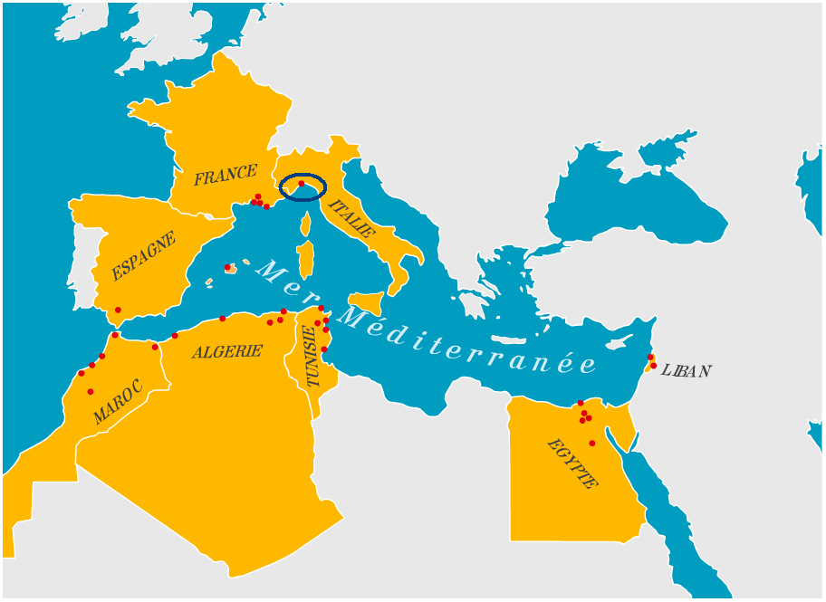
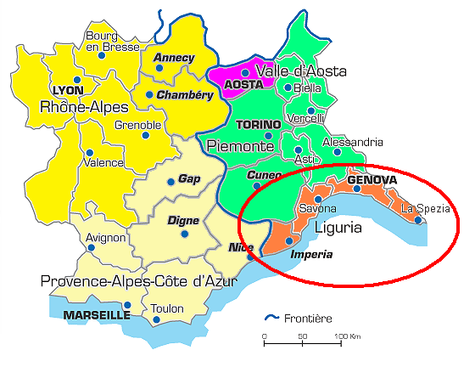
…and in Liguria?
Liguria … is a bridge between….
North and South
East and West
The mountains and the sea
Europe and the Mediterranean
……….
High-tech Clusters may be a bridge
between past and future

Slide 4
High-Tech Clusters in Liguria
Integrated Intelligent Systems and Technologies (established in 2005)
Ligurian District of Marine Technologies (established in 2009)

Slide 5
- Consortium Structure

Slide 6
- Integrated Intelligent Systems and Technologies
ITALIAN GOVERNMENT
REGIONE LIGURIA
Consortium SIIT-PMI
Founded in Genoa on July 2006
83 Small & Medium Enterprises
Overall SIIT-PMI working people: 1830
Global Business volume: 220 M€ p.y.
University
Departments
Turnover | Number of Enterprises | Working People
> 10 M€ | 7 | 666
1-10 M€ | 27 | 870
< 1 M€ | 49 | 279
- CNR
Major LE’s
SME’s
DIMSET
ICT Area
Industrial Area

Slide 7
Six main Areas of Interest
Infomobility: Services and products in transport and logistics, to facilitate cooperation and interoperability between trade operators in the various sea, land and air application domains
Security: Physical and IT security applications with reference to open, crowded public spaces, controlled access sites, large sites and critical infrastructures, protection of coast lines and borders, civil vehicle protection
Automation: Development of applications in the field of “extended” automation in complex scenarios also favouring the passage of the manufacturing industry from a “resource intensive” model to a “knowledge intensive” model, with reference to various application contexts
Health: Applications to assist in diagnosis and therapeutic treatment guided by measurements and images
Complex Organizations : Enabling the definition of functional applications to develop evolved organizational models
Energy: Monitoring, surveillance and diagnostics systems; systems to support operator/process interaction, process modeling and simulation

Slide 8
Four Complementary ad Transversal Areas
Aeronautics
Telecommunications
Emergent Technologies
Services
Six Activity domains
Start-up and management
Infrastructures
Industrial Research
Training
Pre-competitive development and technology transfer
Internationalization

Slide 9
Industrial Research
1st Phase - Research projects presented in 2008-2009 (starting in 2010)
“Slim-Port”
Covering all aspects of Infomobility, Logistics, Transportation and Security (physical and environmental, land and marine) related to port activity.
Promoted by MSE (Ministry of Economic Development) within the “Industria 2015” framework
Total funding: ≈ 14 M€
“S.E.C. – PROCESS” Security Expertise Center
Project for construction of a center for the security that aims to become the first national qualification and certification of products, solutions and services for the security.
Total funding: ≈ 4 M€
2nd Phase - Research projects to launch within 2010
“Call for proposal” opened in February 2010.
Planned start of activities within one year (Spring 2011)
Total funding: ≈ 30 M€

Slide 10
Further initiatives (1/3)
Pre-competitive development and Technology transfer:
About 40 projects on the main Areas of Interest (Info-mobility, Security, Automation, Health, Complex organizations, Energy)., with the aim of implementing technology transfer projects NR) to SMEs.
Total funding: ≈ 6 M€
Training
2008 - Post graduate Course on “Advanced Technologies for Integrated Intelligent Systems”.
1000 hour program of educational activities and stage, for 18 graduates and employed persons, for a selective specialization on the main Areas of Interest .
2009 - Post graduate Course on “International Business Leadership”
(in association with Fondazione Ansaldo)
1500 hour program for 20 graduates and employed persons on 1) Business Focus; 2) Process, Knowledge & People Value; 3) Execution ;4) Innovation & Change.

Slide 11
Further initiatives (2/3)
Internationalization
Guidelines
Promote initiatives paying specific attention to SME’s
Support the organization of demonstrative systems to facilitate and accelerate the trade penetration process
Organize meetings and contacts with European and Extra-European clusters
Identify scenarios and approaches to promote marketing actions.
Main goals
Favour the growth of SMEs and of the SIIT Cluster towards emerging territories and markets
Promoting partnerships and development of activities in cooperation with European and Extra-European High-Tech Clusters (already operating a MoU with Pôle Capenergies)
Create a common portfolio of offer of services and products of the SMEs to promote abroad
Worldwide promotion and spread of the technologies of SIIT

Slide 12
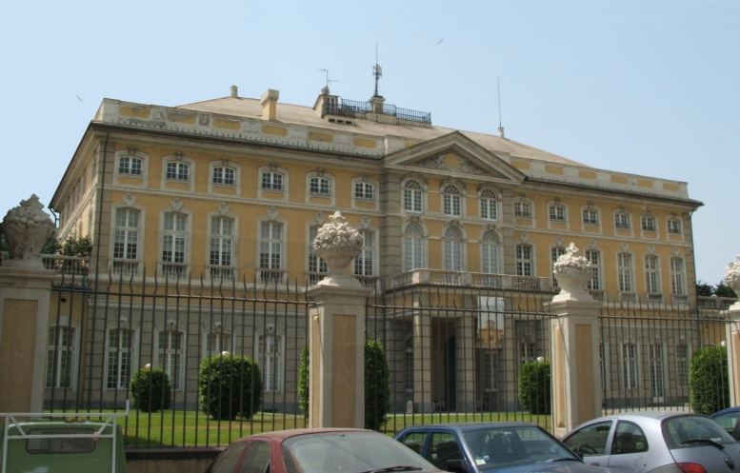
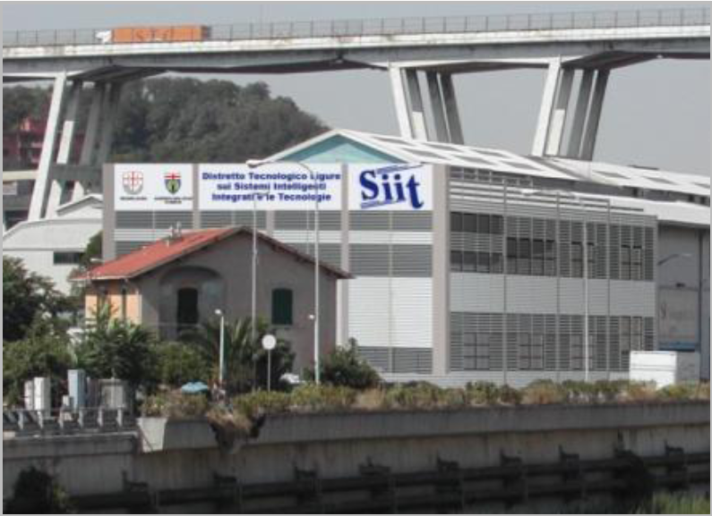
Further initiatives (3/3)
Infrastructure (available in 2010)
Main executive offices
+ GRID node
Villa Bombrini – Genova Cornigliano
The SIIT Joint Lab
1500 m² in Genova Campi
Six laboratories: Security, Infomobility, Automation, Energy, HW & SW Technologies and Processes
+ offices, meeting rooms and show rooms

Slide 13
Ligurian District of Marine Technologies
Established July 2009
Shareholders are:
Large Enterprises
(Fincantieri, Finmeccanica, Intermarine, Termomeccanica, Cantieri San Lorenzo)
More than 60 SME’s grouped in “Consorzio Tecnomar”
University of Genoa
Public Research Centers (CNR, INGV, ENEA)
Cassa di Risparmio della Spezia
Chamber of Commerce of La Spezia
Liguria Region
Ministries of Defence and of University and Research

Slide 14
Areas of Interest
Macro Areas :
Defence Naval System Development :
Commercial Ships and Leisure Yachts and Megayachts Development
Monitoring, Protection, Safety and Security for Marine Environment
Research Areas :
Innovative and Environmentally Sustainable Product/Process in Shipbuilding (military and civil)
Innovative and Eco-sustainable products for Yachts, Megayachts and Interior Design
Off –Shore Platform for Energy Production and Regassifier
Naval and Maritime Systems (military and civil), Automation Equipment, Components and Instrumentations;
Instruments and Equipment for Undersea Application
Logistics
Advanced Materials for marine applications.

Slide 15
Strategic Objectives and Guidelines
Promoting base and applied research by sharing knowledge among Universities, Research institutions and enterprises;
Project elaboration/promotion and laboratory creation in line with European strategic objectives;
Identification and activation of funding processes and/or Venture Capital at regional, national and European level;
Promoting sinergies with other national technology districts;
Developing international relations between the scientific and the business communities of Liguria and other technopoles through memorandums of understanding and partnership agreements and related marketing activities (e.g.: the Partnership agreement with Pole Mer Paca and Bretagne of June 2009)

Slide 16
Activity program and funding
A Joint Action of MIUR, MiSE and Liguria Region
will support:
21,00 M€ for Industrial Research / Large Projects
5,00 M€ for Technological Infrastructure
14,00 M€ for Industrial Research Project and Enterprises Internationalization, focusing on SMEs
8,00 M€ for High Level Education.
With private investments the total funding will reach 120,00 M€

Slide 17
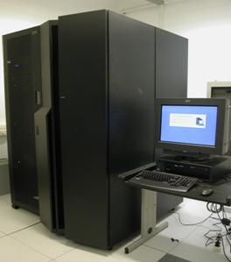
Location and Technological Infrastructure
DLTM is presently negotiating with the Italian Navy to use areas with direct sea access
Four Labs for research centers and enterprises
Fluidodynamics
Advanced Materials
High Performance Computing
Multifunctional Hyperbaric Chamber
In particular the
High Performance Computing Center (HPC)
is already available and operational providing advanced services to Enterprises, Universities and Research Centers

Slide 18
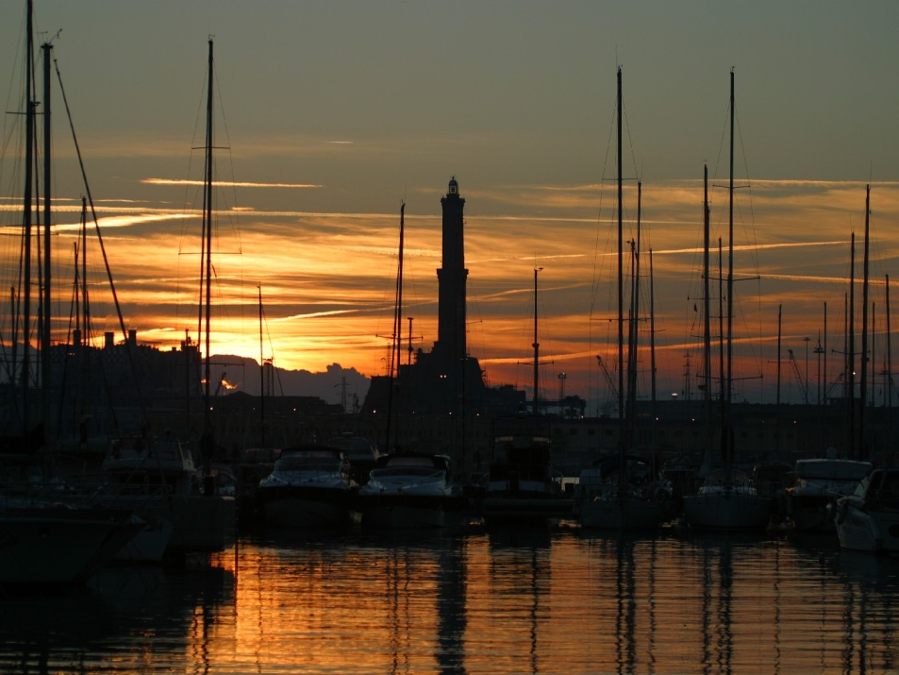
Thank You from….
Genoa port and lighthouse

